Slide 1

Climate Zone Clustering of World Cities
Iacob Mihaela Iasmina
Big Data, Year 2
Machine Learning

Slide 2
Motivation
Understanding climate similarity between cities is important for:
Urban planning
Climate adaptation
Environmental risk assessment
Goal: Discover climate zones directly from data.
Instead of using predefined climate classes, this project explores whether unsupervised machine learning can automatically discover climate zones based purely on observed climate features.

Slide 3
Data Sources
City locations: Natural Earth (largest world cities)
Climate data: Open-Meteo Historical Weather API (ERA5-based)
Time period: 2019–2023
Sample: 40 major global cities

Slide 4
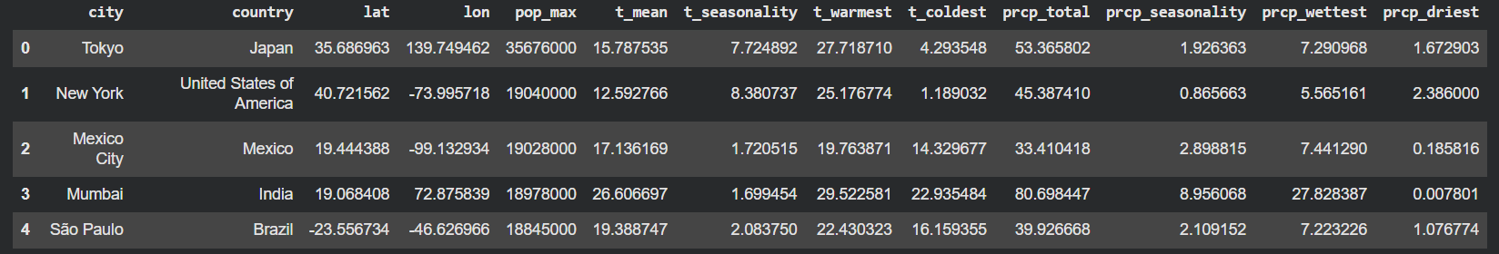
Feature Engineering
Daily data was aggregated into climate-like features:
Mean annual temperature
Temperature seasonality
Warmest month temperature
Coldest month temperature
Total precipitation
Precipitation seasonality
Wettest & driest month precipitation
This transforms short-term weather data into long-term climate signatures suitable for clustering.

Slide 5
Methods
Unsupervised clustering methods:
K-Means
Agglomerative clustering
DBSCAN
Preprocessing: Standardization (z-score scaling)
Evaluation:
Silhouette score
Davies–Bouldin index
Because this is an unsupervised problem, no labels are available. Therefore, internal clustering metrics such as silhouette score and Davies–Bouldin index were used to compare models.

Slide 6
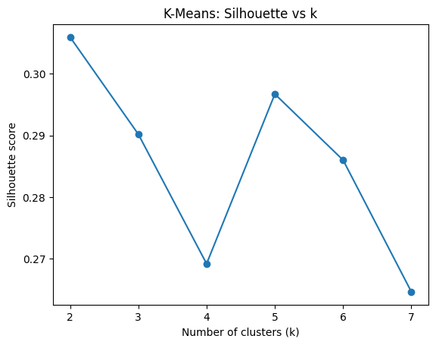
Choosing the Number of Clusters
Tested k = 2 to 7
Best silhouette score at k = 2,
because it provides the best balance between cohesion and separation, so two main climate groups were selected.

Slide 7
Model Comparison
 | Model | Clusters | Silhouette | Davies-Bouldin
0 | K-Means | 2 | 0.305945 | 1.227786
1 | Agglomerative | 2 | 0.300383 | 1.190113
2 | DBSCAN | 6 | -0.023299 | 2.747958

Slide 8
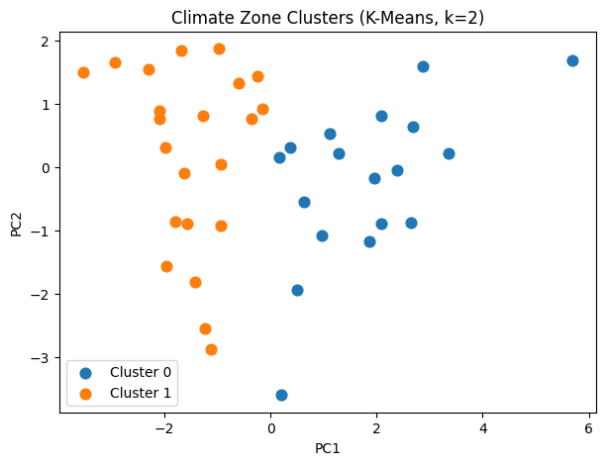
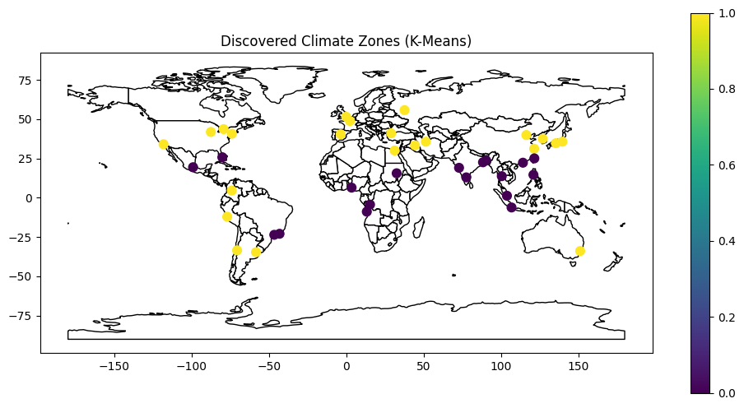
Results
The PCA visualization shows a clear separation between the two clusters in reduced feature space.
Cluster 0: tropics & subtropics
Cluster 1: temperate & continental regions

Slide 9
Cluster interpretation
 | t_mean | t_seasonality | t_warmest | t_coldest | prcp_total | prcp_seasonality | prcp_wettest | prcp_driest
cluster_kmeans
0 | 24.97 | 2.14 | 27.82 | 21.38 | 51.39 | 2.91 | 9.64 | 0.86
1 | 15.23 | 6.83 | 24.97 | 5.56 | 26.94 | 1.10 | 4.54 | 0.90
Cluster 0:
Hot, low seasonality, high rainfall
Tropical / subtropical climates
Cluster 1:
Cooler, high seasonality
Temperate & continental climates

Slide 10
Conclusions & Limitations
Conclusions
Unsupervised learning can discover meaningful climate zones
Results align with known global climate patterns
Simple models + good features work well
Limitations
Limited to major cities
Short time period (5 years)
Not a replacement for formal climate classifications
Despite its simplicity, the approach produces climate zones that are intuitive and spatially coherent.

Slide 11
Thank you for your time!

